Slide 1
CAPSTONE PROJECT - AGRICULTURE / AGRITECH
Predicting Crop Yield
Using Environmental And Agricultural Data To Forecast Harvests, Guide Farmer Decisions, And Inform Agricultural Policy
TEAM CODEX
2026

Slide 2
BACKGROUND
WHY PREDICT CROP YIELD?
Farmers face constant uncertainty arising from changing rainfall patterns, temperature patterns, temperature variations, pesticide use, crop characteristics, and geographical differences, making it difficult to plan production, allocate resources, and manage market risks.
Forecasting yield ahead of harvest turns that uncertainty into a plannable input - for the farmer, and for the policymakers who support them.
🔍
Explore
🌾
Uncover which features improves yield
🌾
📈
Predict
Build an accurate regression model
🌾
Advise farmers
OBJECTIVE
Turn predictions into input & risk decisions
Identify which environmental and agricultural features most influence crop yield, build a regression model to predict it, and translate the results into practical guidance for farmers and policy planning.
🌾
🏛️
Inform policy
Support food-security & planning decisions
2
Crop Yield Prediction | Capstone Project
2

Slide 3
DATA UNDERSTANDING
Dataset Overview & Approach
🗂
DATA SOURCE
APPROACH
Kaggle — Crop Yield Prediction Dataset (yield_df.csv)
↻
EDA → Regression Modelling → Feature Interpretation → Decision Support
28,242
101
10
23
7
0
raw records
countries
crop types
years covered
1990 - 2013
variables
missing values
Variables in yield_df.csv
Target: hg/ha_yield – Crop yield in hectograms per hectare
Predictors: Area (Countries), Item (Crop types), average_rain_mm_per_year, pesticides_tonnes, avg_temp
3
Crop Yield Prediction | Capstone Project
3

Slide 4
DATA PREPARATION
Cleaning & Quality Checks
1
2
3
4
Drop index column
Remove duplicates
Reset index
Review outliers
The auto-generated "Unnamed: 0" column carried no analytical value and was removed.
2,310 exact duplicate records were identified (masked earlier by the index column) and removed.
Row indices were reset to a clean, continuous sequence after de-duplication.
1,918 IQR outliers in yield traced to root/tuber crops (potatoes, cassava, yams) - genuine agronomic variation, so retained.
Result: 28,242 → 25,932 clean records across 101 countries, 10 crops, and 23 years
no missing values, ready for EDA and modelling.
4
Crop Yield Prediction | Capstone Project
4

Slide 5
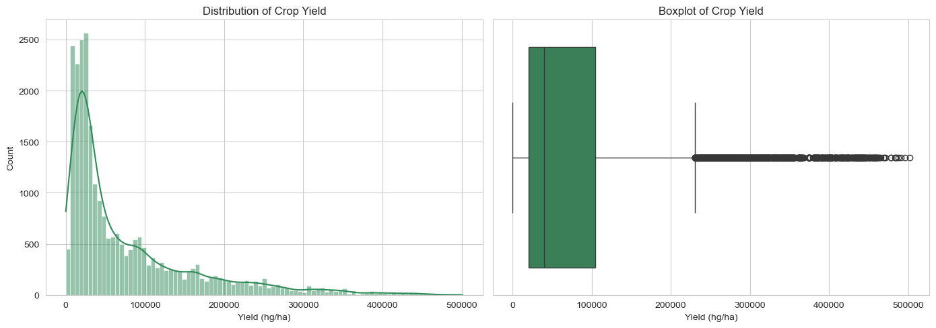
EXPLORATORY DATA ANALYSIS · UNIVARIATE
Yield Is Strongly Right-Skewed
Median: 39,530 hg/ha
well below the mean
Mean: 76,978 hg/ha
pulled up by a long tail
Skewness ≈ 1.81
high-yield root/tuber crops dominate the tail
Implication: the skew (and the outliers, which reflect real crop biology, not errors) points toward tree-based models over plain linear regression for capturing yield's true shape.
5
Crop Yield Prediction | Capstone Project
5

Slide 6
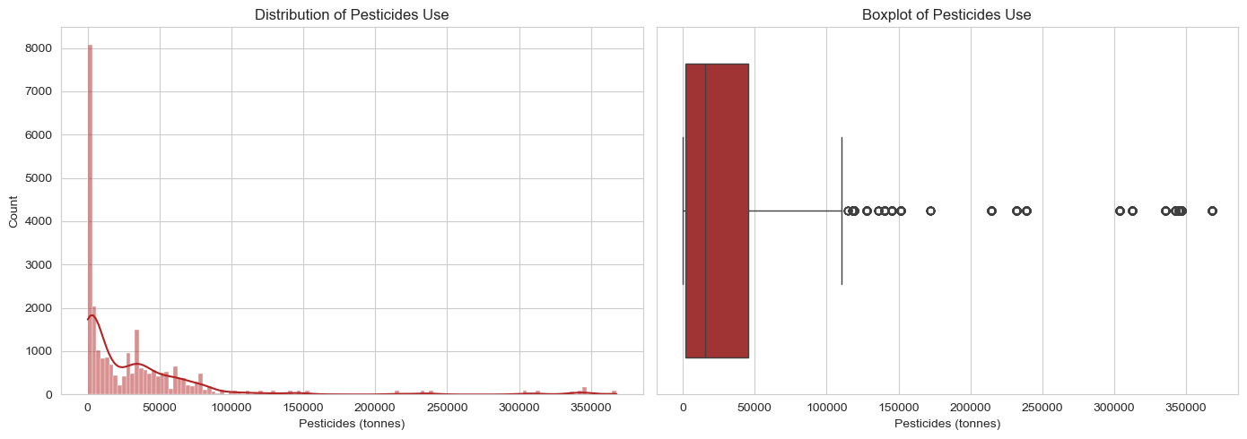
EXPLORATORY DATA ANALYSIS · UNIVARIATE
Climate & Input Variables Vary Widely
Variable | Range | Skew | Shape
Rainfall | 51 – 3,240 mm/yr | 0.86 | Moderate right skew
Temperature | 1.3° – 30.7°C | -0.71 | Mildly left skew (most symmetric)
Pesticides | up to 367,778 t | 3.64 | Extreme right skew
Pesticide usage (tonnes) — the most heavily skewed environmental variable
Implication: The wide variation and skewness observed in pesticide usage suggest that preprocessing and robust machine learning models are more appropriate than simple linear approaches.
6
Crop Yield Prediction | Capstone Project
6

Slide 7
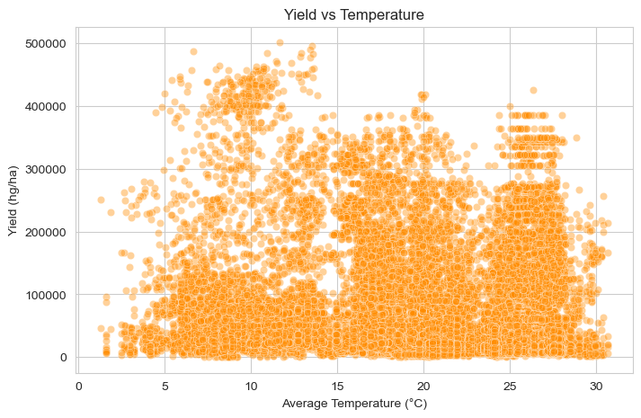
EXPLORATORY DATA ANALYSIS · BIVARIATE
Individual Climate Variables show Weak Relationships with Yield
Correlation with yield
Rainfall
No visible linear pattern
r ≈ -0.004
Temperature
Weakest, but strongest of the three — mild heat-stress signal
r ≈ -0.11
Pesticides
Likely a scale confound (bigger countries, more of both)
r ≈ 0.07
Yield vs. Average Temperature
7
Crop Yield Prediction | Capstone Project
7

Slide 8
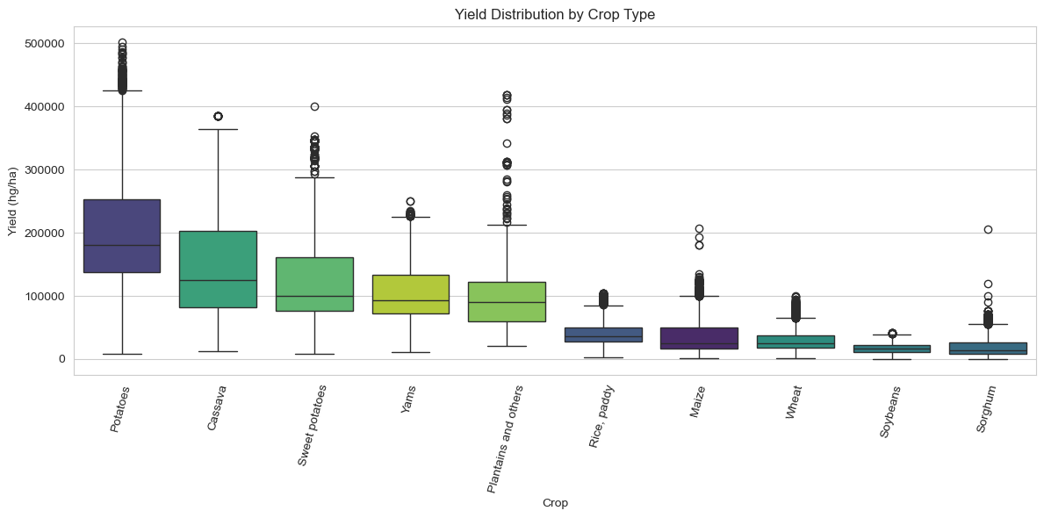
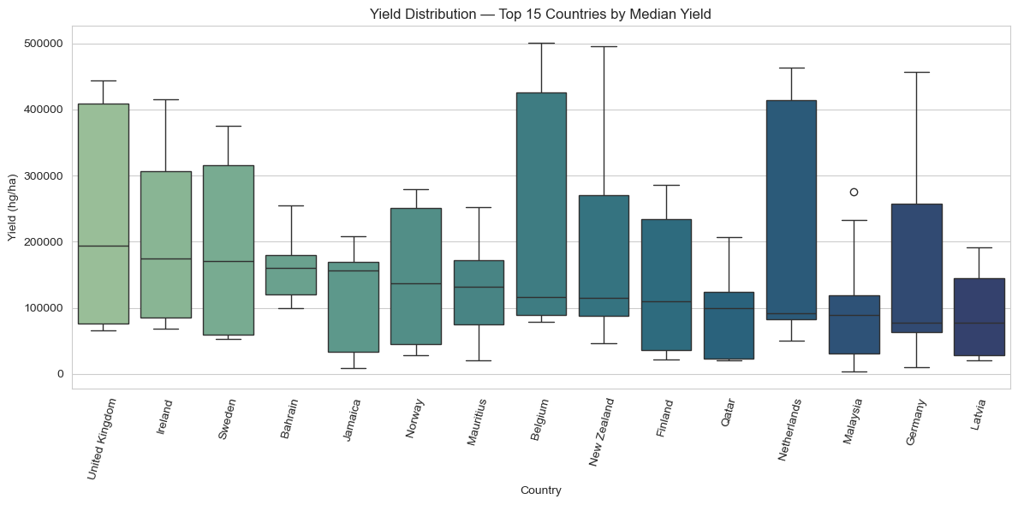
EXPLORATORY DATA ANALYSIS · BIVARIATE
Crop Type & Location Dominate Yield
Median yield by crop
Median yield — top 15 countries
Potatoes, cassava, sweet potatoes, yams and plantains post median yields 3–6x higher than cereals like wheat and sorghum (harvested weight), not farming superiority. Countries such as the United Kingdom, Ireland, and Sweden recorded the highest median crop yields in the dataset.
8
Crop Yield Prediction | Capstone Project
8

Slide 9
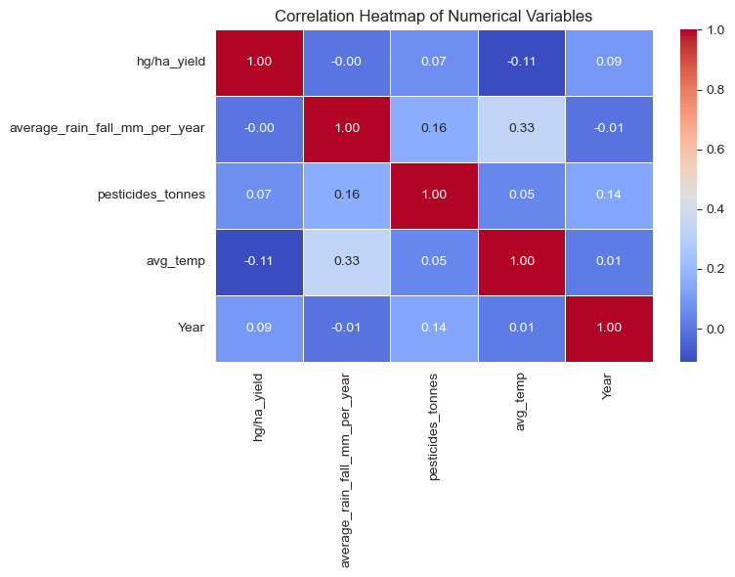
EXPLORATORY DATA ANALYSIS · MULTIVARIATE
Weak Links Between Numeric Predictors
What the heatmap tells us
No numeric variable correlates strongly with yield - temperature (-0.11) is the strongest.
Rainfall and temperature correlate more with each other (r ≈ 0.33) than either does with yield - shared climate-zone structure.
Low correlation among predictors is good news for modelling: multicollinearity is unlikely to be a major issue.
Since raw climate variables explain so little on their own, categorical variables (Item, Area) should carry most of the predictive power.
9
Crop Yield Prediction | Capstone Project
9

Slide 10
EDA — KEY TAKEAWAYS
What the Data Told Us Before Modelling
Yield is skewed
Crop & country dominate
Climate is complementary
Time trend exists
Right-skewed target (skew ≈ 1.81).
Item and Area explain far more variation than any single climate reading.
Rainfall, temperature and pesticide use carry weak individual signal but add nuance once crop/location are known.
Yield shifts across the 23-year window - Year is worth retaining as a proxy for technology and practice change.
10
Crop Yield Prediction | Capstone Project
Crop Yield Prediction | Capstone Project
10
10

Slide 11
PREDICTIVE MODELLING
From Features to Forecast
Preprocessing
Three models compared
One-Hot Encoding converts Area and Item into numeric indicators, expanding the feature space while preserving category information.
80 / 20 train-test split - models trained on 80%, evaluated on an unseen 20% holdout.
Target kept in its original scale (hg/ha) so predictions and errors stay directly interpretable.
Linear Regression
Baseline benchmark — assumes linear relationships
Random Forest
Captures non-linear interactions, robust to outliers, no scaling needed
XGBoost
Gradient boosting - tests whether boosting beats bagging on this data
Also applied: RandomizedSearchCV hyperparameter tuning on the Random Forest, 5-fold cross-validation to test stability, permutation-based feature importance, partial dependence plots for climate variables, and tree-level prediction spread as an uncertainty signal.
11
Crop Yield Prediction | Capstone Project
11

Slide 12
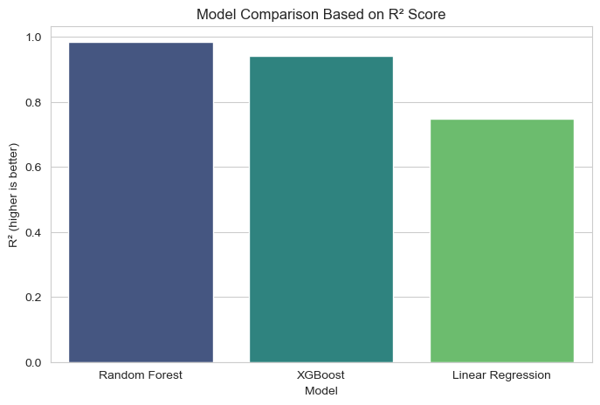
PREDICTIVE MODELLING
Random Forest Wins on Every Metric
Model | R² | RMSE | MAE
Random Forest (tuned) | 0.985 | 10,522 | 3,963
XGBoost | 0.943 | 20,399 | 12,146
Linear Regression | 0.749 | 42,682 | 29,921
R² = 0.985 means the tuned Random Forest explains ~98.5% of yield variation on the held-out test set — with the lowest error of any model tried.
Hyperparameter tuning (400 trees, unrestricted depth) confirmed the Random Forest configuration was already close to optimal.
Random Forest achieved the highest R² and the lowest prediction errors, making it the most suitable model for crop yield prediction.
12
Crop Yield Prediction | Capstone Project
12

Slide 13
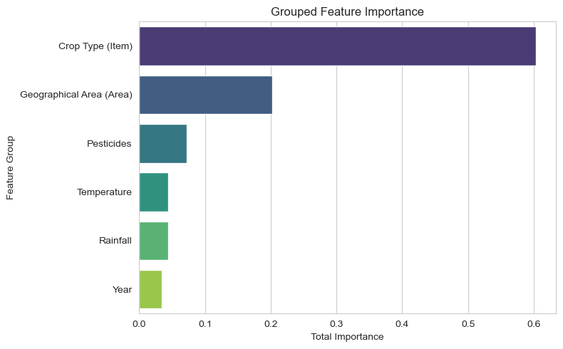
MODEL INTERPRETATION
What Really Drives Yield?
Crop Type (Item)
60.4%
Geographic Area
20.2%
Pesticide Usage
7.2%
Temperature, Rainfall, Year
remainder
Bottom line: what you grow and where you grow it explain ~80% of yield variation. Individually, Item_Potatoes is the single strongest feature (≈37%), with pesticide usage the top environmental signal.
Grouped feature importance (Random Forest)
13
Crop Yield Prediction | Capstone Project
13

Slide 14
MODEL INTERPRETATION
Reading Predictions With Appropriate Caution
Cross-validation caveat
Example test-set observation
5-fold CV produced R² scores from 0.516 to 0.785 (mean 0.684) — well below the 0.985 seen on the single test split.
The single-split result is likely optimistic; performance should be read cautiously when applied beyond the training distribution.
87,926 hg/ha actual
Predicted: 110,379
The lower cross-validation performance indicates that model accuracy varies across different data partitions, suggesting that the single test-set performance may be optimistic.
0
237,338
Heuristic 90% range (±1.645 × tree std. dev.)
Prediction uncertainty as a risk signal
Random Forest's individual trees each produce a prediction - their spread is a usable proxy for confidence: tight spread = low risk (familiar case); wide spread = higher risk (unusual crop/region/climate combination).
Tree disagreement (std. dev.): 77,179 hg/ha — a wide spread flags this as a lower-confidence prediction worth cautious interpretation.
These ranges are heuristic risk indicators, not formally calibrated statistical intervals.
14
Crop Yield Prediction | Capstone Project
14

Slide 15
APPLICATIONS
From Prediction to Decision
🌾 For Farmers
🏛️ For Policy
Input allocation - size fertilizer/pesticide spend to the yield a plot is actually forecast to produce.
Risk-aware planning - wide prediction ranges signal when to hedge (diversify crops, buy insurance, delay big spend).
Market & storage timing - an early yield estimate supports selling, storage, and logistics decisions ahead of harvest.
Crop choice - since crop type dominates yield, forecasts by crop help compare options for a given plot and climate.
Food security planning - early production estimates by region/crop support national supply planning.
Targeted input support - direct subsidies, extension services, and irrigation investment to areas forecast for shortfall.
Proactive response - flag likely shortfalls early enough to plan imports or reserves.
Evidence-based planning - reliable forecasts strengthen the data behind agricultural policy formulation.
15
Crop Yield Prediction | Capstone Project
15

Slide 16
CONCLUSION
A Reliable, Interpretable Yield Forecast
The tuned Random Forest Regressor explains 98.5% of test-set yield variation (R² = 0.985), decisively outperforming Linear Regression (0.749) and XGBoost (0.943). Crop type and geographic area are the dominant drivers of yield, with pesticide use, temperature, rainfall, and year contributing complementary — though comparatively modest - signal.
Deploy the tuned Random Forest as the production forecasting model, paired with tree-spread uncertainty bands.
1
Interpret single-split accuracy cautiously — cross-validation shows performance varies by data partition.
2
Use crop- and area-specific forecasts to guide farmer input allocation and risk planning.
3
Feed regional forecasts into food-security and input-support policy planning ahead of harvest.
4
Crop Yield Prediction | Capstone Project
Crop Yield Prediction | Capstone Project
16
16

Slide 17
THANK YOU FOR LISTENING
Crop Yield Prediction | Capstone Project
Crop Yield Prediction | Capstone Project

